Slide 1
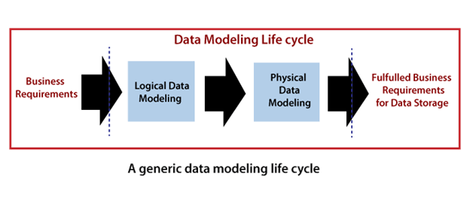
Data Modeling Life Cycle

Slide 2
Conceptual Data Model
A conceptual data model recognizes the highest-level relationships between the different entities.
Characteristics of the conceptual data model
It contains the essential entities and the relationships among them.
No attribute is specified.
No primary key is specified.

Slide 3
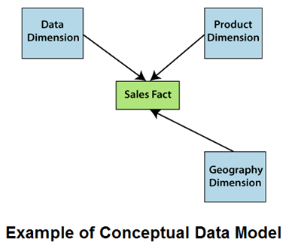

Slide 4
Logical Data Model
A logical data model defines the information in as much structure as possible, without observing how they will be physically achieved in the database.
The primary objective of logical data modeling is to document the business data structures, processes, rules, and relationships by a single view - the logical data model.

Slide 5
Features of a logical data model
It involves all entities and relationships among them.
All attributes for each entity are specified.
The primary key for each entity is stated.
Referential Integrity is specified (FK Relation).

Slide 6
The phase for designing the logical data model which are as follows:
Specify primary keys for all entities.
List the relationships between different entities.
List all attributes for each entity.
Normalization.
No data types are listed

Slide 7
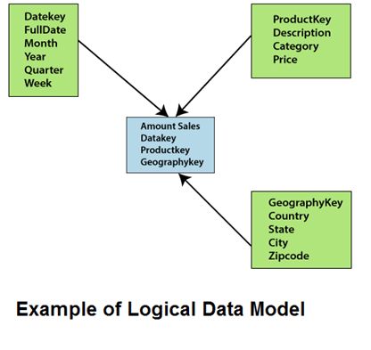

Slide 8
Physical Data Model
Physical data model describes how the model will be presented in the database.
A physical database model demonstrates all table structures, column names, data types, constraints, primary key, foreign key, and relationships between tables.
The purpose of physical data modeling is the mapping of the logical data model to the physical structures of the RDBMS system hosting the data warehouse

Slide 9
Characteristics of a physical data model
Specification all tables and columns.
Foreign keys are used to recognize relationships between tables.
The steps for physical data model design which are as follows:
Convert entities to tables.
Convert relationships to foreign keys.
Convert attributes to columns.

Slide 10
